Slide 1


Slide 2
“The focus of innovation has shifted from being engineering-driven to design-driven, from product-centric to customer-centric, and marketing-focused to user-experience-focused”
Linda Naiman Founder of Creativity at work

Slide 3
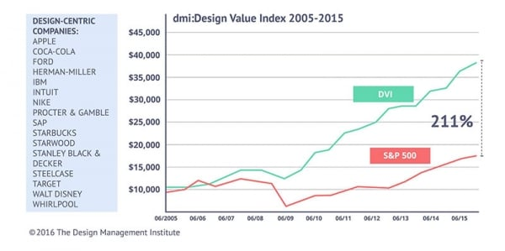
Design thinking
Design-led companies such as Apple, Pepsi, Procter & Gamble and SAP have outperformed the S&P 500 by an extraordinary 211%.
By Design Management Institute

Slide 4
What is Design Thinking?
A problem solving approach revolving around end user experience (UX), promoting:
Empathizing with users and immersing our selves into the CX to identify and better understand the pain points
Defining the problem from the end user point of view and challenges assumptions
Ideate with the end user, i.e. get the end user to be part of the design decisions
Prototyping and evaluating iteratively until reaching a better UX

Slide 5
How are we doing it ?
Understand current pain points for customers
Defining problems from a UX point of view
Ideation? - Help & motivate the team to develop innovative ideas to improve UX and increase revenue:
Prototyping? - Implement niche ideas through Internship program and avoid impact on business roadmap
Prototype evaluation? - Team provides feedback iteratively to fail early and succeed sooner
Follow a heuristic approach to new Design problem solving
Notes:
Empathizing with end users - Understand current pain points for customers:
Listening to our customers:
e.g. Our customers told us that our release lifecycle are a bit slow → Impact:
Bugs are no addressed quickly
Product feature are not using the last security patches and technology
Listening to QA team:
e.g. It takes too long to validate a SGW WF end to end, which limits the extend of TCs to be executed → Impact:
Risk of unidentified regressions that could be leaked to customers
Too manual and redundant activities leading to waste of time and can reduce motivation of QA team
Watching our competitors and following technology trends:
e.g. Cloud readiness of the product including:
Lack of elastic scalability of the SGW service
Defining problems from a UX point of view,
Ideation? - Help & motivate the team to develop innovative ideas to improve UX and increase revenue:
e.g. How can we improve competitiveness by:
Accelerating deliveries consistently and sustainably
Reducing deployment and runtime issues for clients
Improve customer support effectiveness, i.e. better service to clients for less effort from our end
Improve design to be more:
User Friendly → easier configuration, deployment and monitoring eXperience
Cloud ready → improve scalability and availability of SGW
Prototyping? - Implement niche ideas through Internship program and avoid impact on business roadmap
Use case of SLTP tool → Reduce manual validation of new developed features
ML exchange emulator → Leverage ML to automate live validation of SGW end to end
Design a bespoke Chatbot API → Looking for ways to improve the end User search eXperience
e.g. by integrating Docs and TechSupport content into one location by leveraging NLU ML techniques
Prototype evaluation? - Team provides feedback iteratively to fail early and succeed sooner
Follow a heuristic approach to new Design problem solving
Use case of Exchange emulator

Slide 6
Future Planning Template
2018
Lack of ML knowledge
Only a single type of attribute could be predicted
2019
Acquired some knowledge on various ML techniques
Use of correlation and ML to propose a better market emulator tooling
2020
Notes:
Problem: Need ability to automate SGW live validation for new developed features
Challenges:
Currently we need to manually interact with the exchange for trade injection
We rely on CCP server availability to perform live testing
Proposed approach: Leverage ML to understand CCP APIs and emulate market behaviours
Project path:
First year 2018 (1 intern student – With some ML knowledge but not a data scientist):
Challenges:
Lack of knowledge on ML techniques & on suitable Technology to solve the problem at hand
Result: We were only able to predict a single type of attributes using classification algorithms
Lesson learnt:
We need to acquire more knowledge about ML techniques
Need to understand how to leverage these ML techniques
Second year 2019 (2 intern students – Not a data scientist)
Challenges:
A datascientist will be more up to speed and knowledgeable to propose better ways
Result: Acquired better ML knowledge, Techniques and Dev environments
Lesson learnt:
Various techniques needed to be applied prior to ML modeling, including:
Reduction of dimensionality (Reduce the number of attributes to predict using ML)
Consider different types of ML algos to predict various types of attributes
ML will not be able to predict random value attributes, so we should look for ways to extract dependency rules between variables
Third year 2020 (2 intern students – One of them is a data sciense student)
Challenges: ???
Result: ???
Lesson learnt: ???

